Slide 1



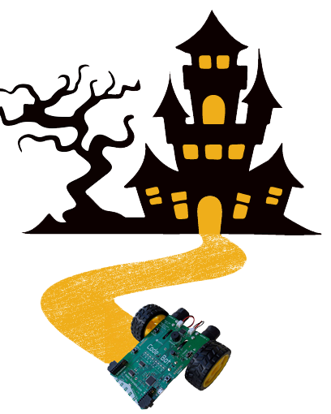
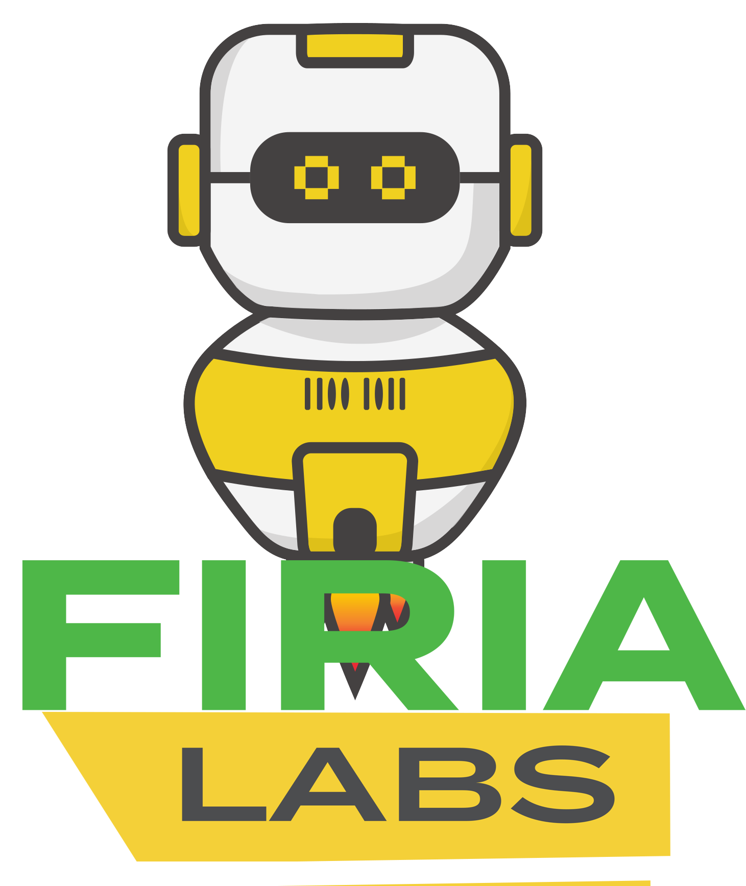
Python Programming with Robotics in CodeSpace
Sponsored by Firia Labs, October 2025
is hereby recognized for completing
Teacher:
Python Programming with Robotics in CodeSpace
Sponsored by Firia Labs, October 2025
is hereby recognized for completing
Teacher:

